Slide 1

Module 2 Spring Framework
Day 14

Slide 2
Agenda
Spring Cloud
AGILE
Docker
Micro Service Best Practice

Slide 3
Cloud

Slide 4
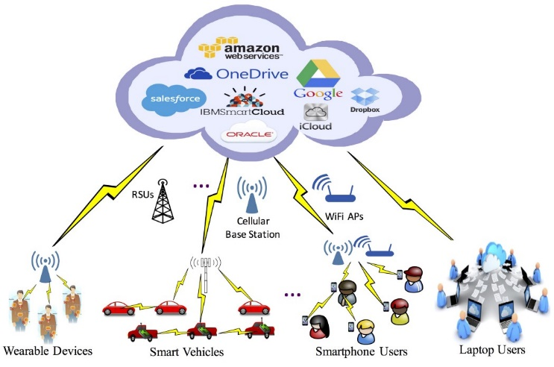

Slide 5
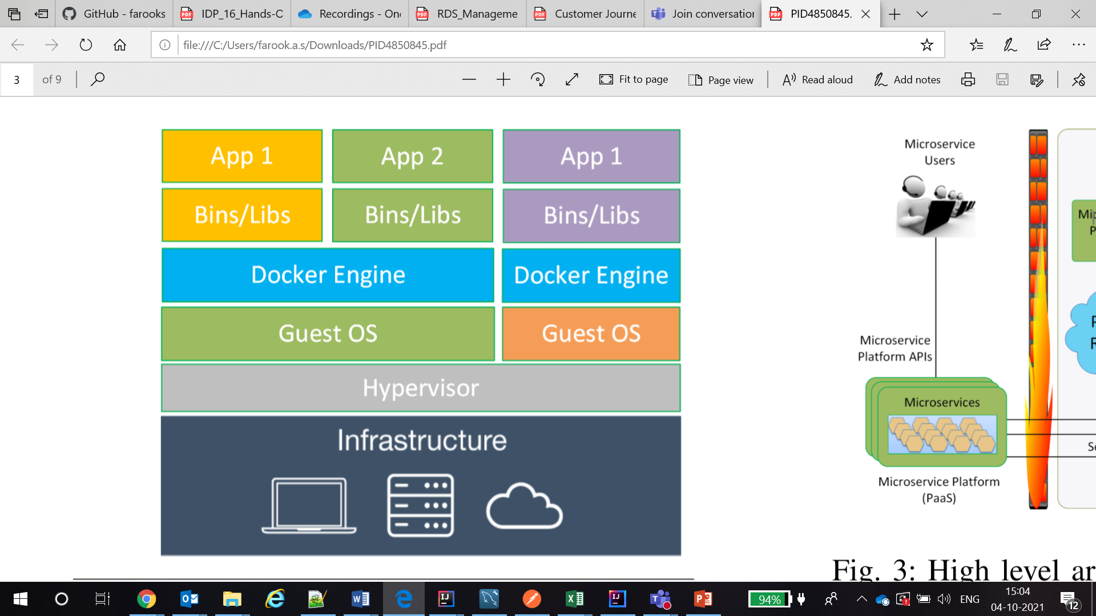

Slide 6
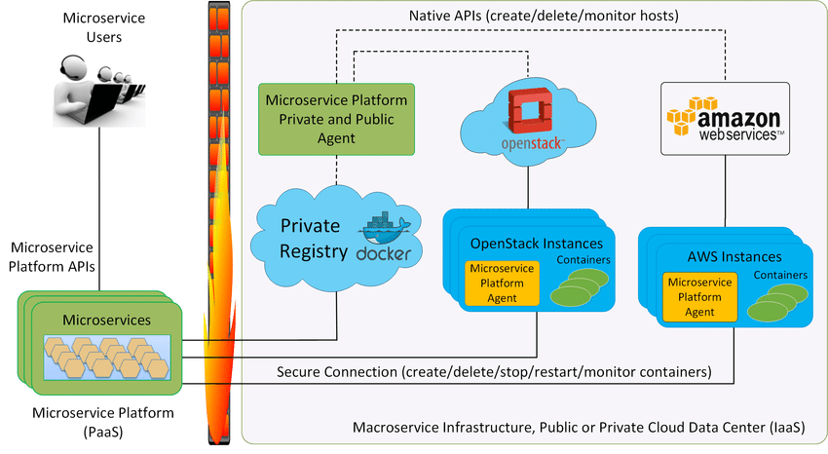

Slide 7
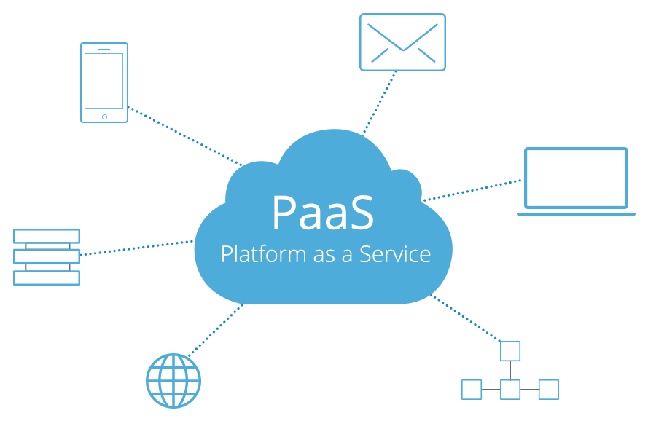
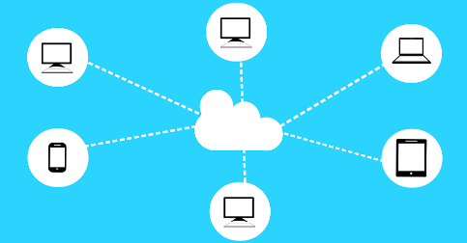
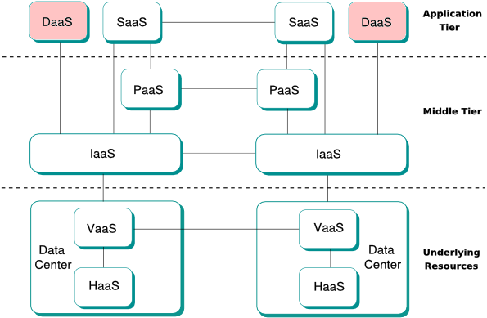
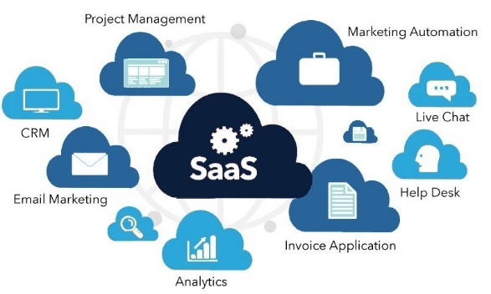
Core Cloud Computing Concepts
IaaS (Infrastructure as a Service)
PaaS (Platform as a Service)
SaaS (Software as a Service)
DaaS (Desktop as a Service)

Slide 8
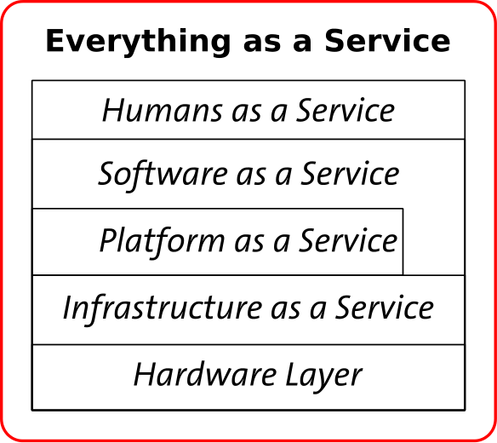
Everything as a Service Era (XaaS)

Slide 9
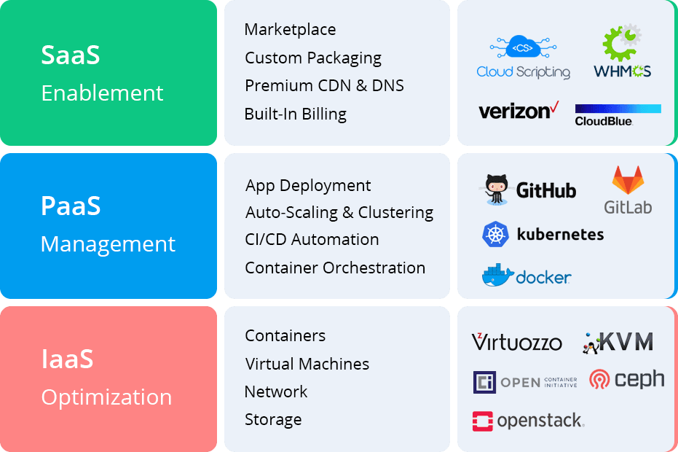
The difference between Paas, Iaas, and Saas Cloud Computing Models

Slide 10
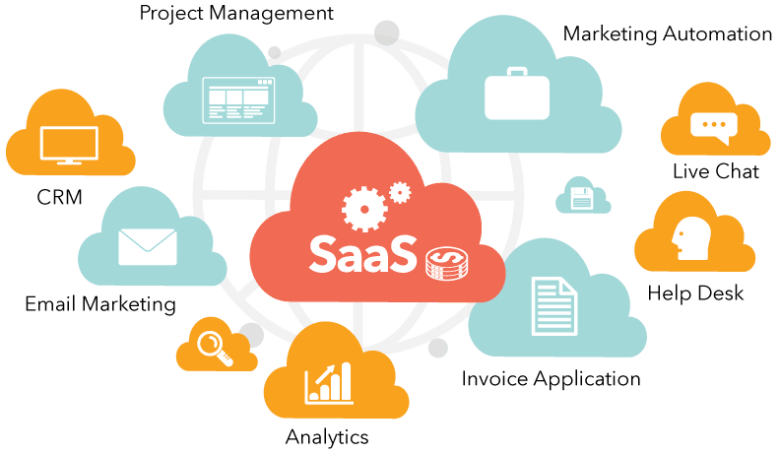
Business apps that use SaaS
Human resource software management
Mobile app development
Customer relations management
Communication and office software
Planning enterprise resource programs
Accounting and payroll programs
Corporate performance management suites

Slide 11
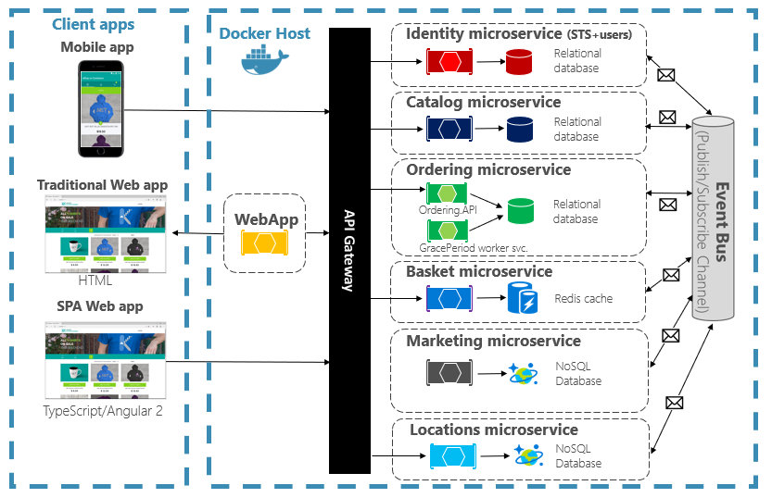
Cloud-native applications

Slide 12
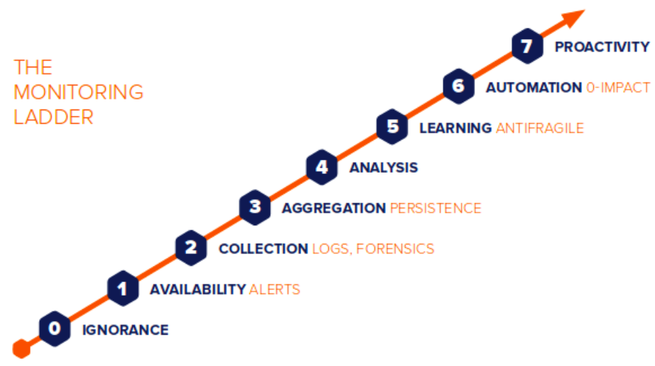
Tools to Monitor Cloud-Native Applications
Kubernetes
PaaS or IaaS
Prometheus
Fluentd
ELK Stack
Grafana
Istio

Slide 13
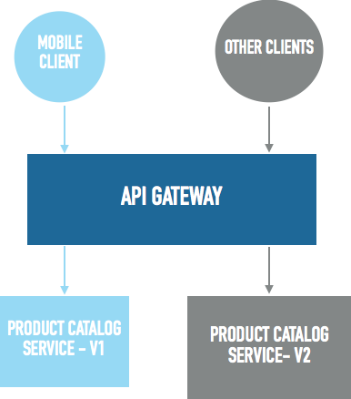
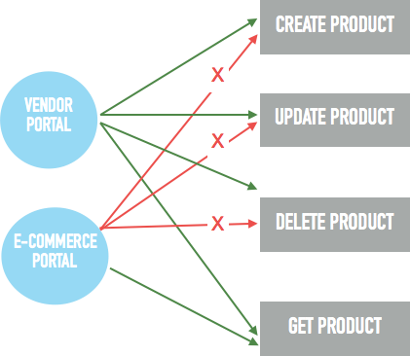
API Gateway using Spring Cloud Gateway
Scenario 1 — Multiple Versions of Service
Scenario 2 — Restricted Access

Slide 14
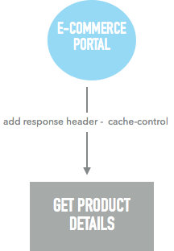
API Gateway using Spring Cloud Gateway
Scenario 3 — Monitoring API Performance
Scenario 4 — Updating Response Header

Slide 15
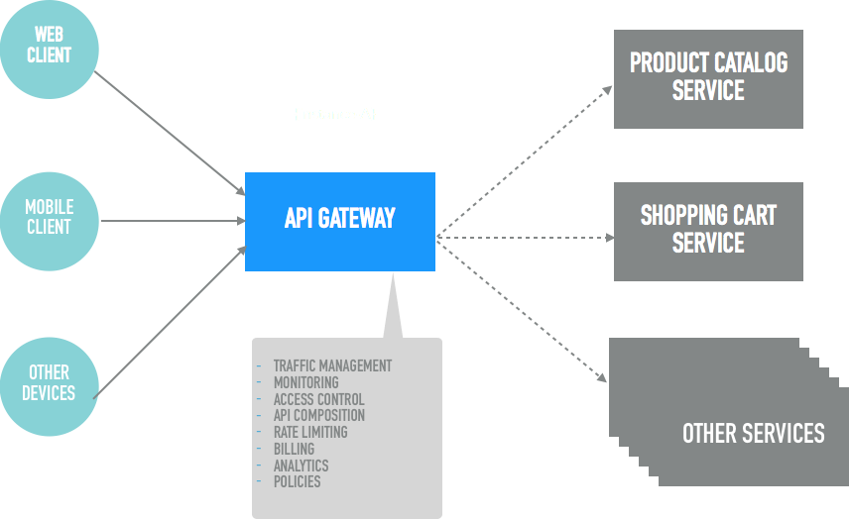
How API Gateway Works?

Slide 16
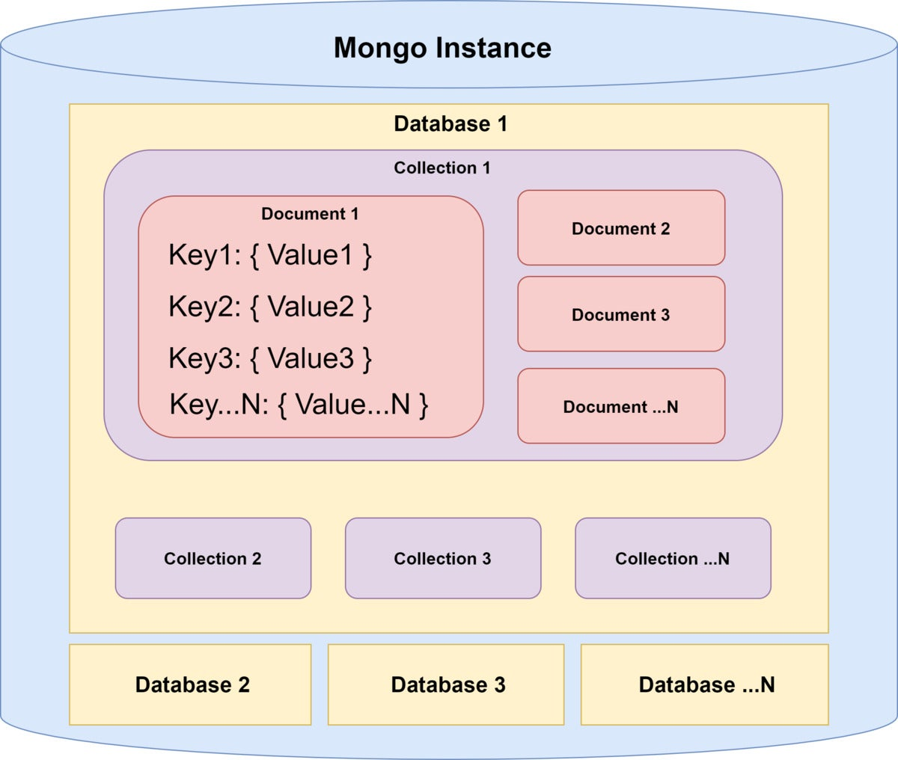
Demo : Spring Cloud gateway with mongoDB

Slide 17
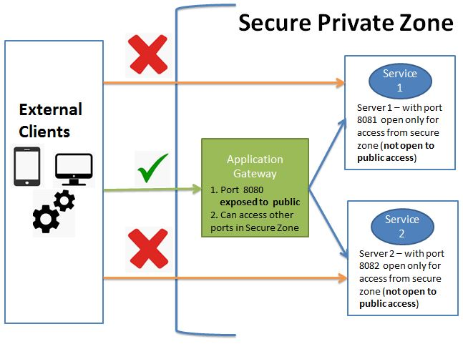
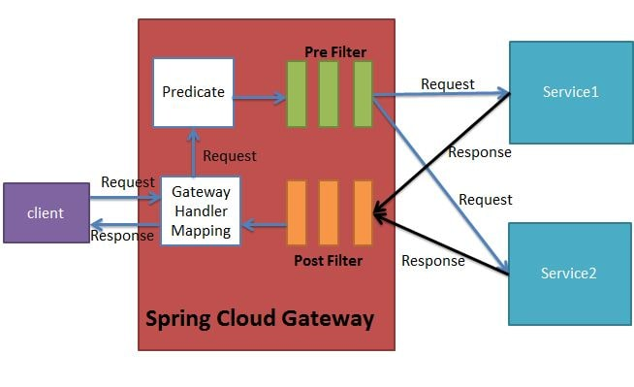
Demo 2: Spring Cloud Gateway

Slide 18
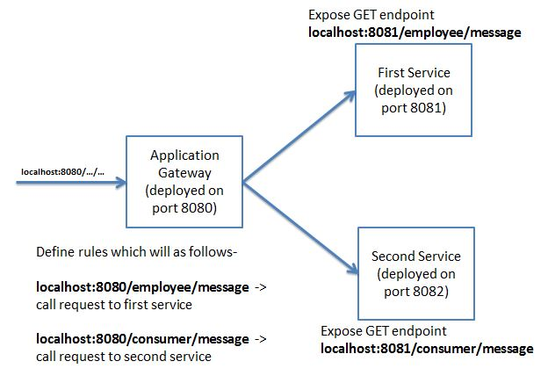

Slide 19
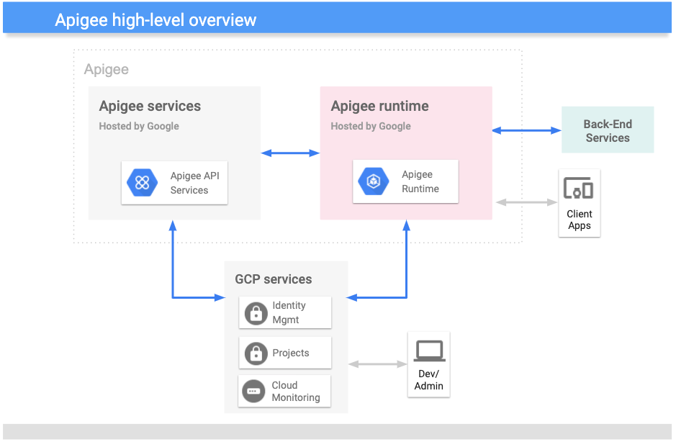
What is an Apigee?

Slide 20
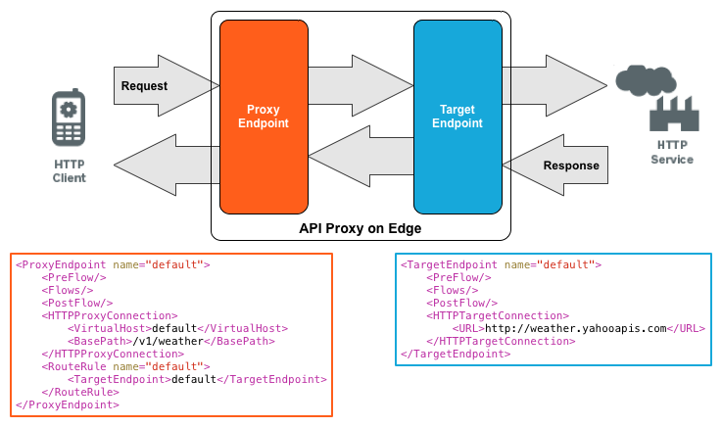
What is an API proxy?

Slide 21
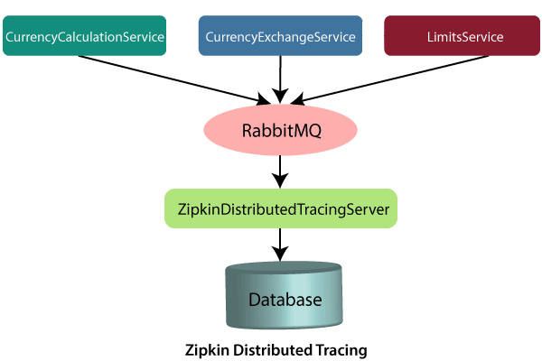
Spring Cloud Zipkin and Sleuth

Slide 22
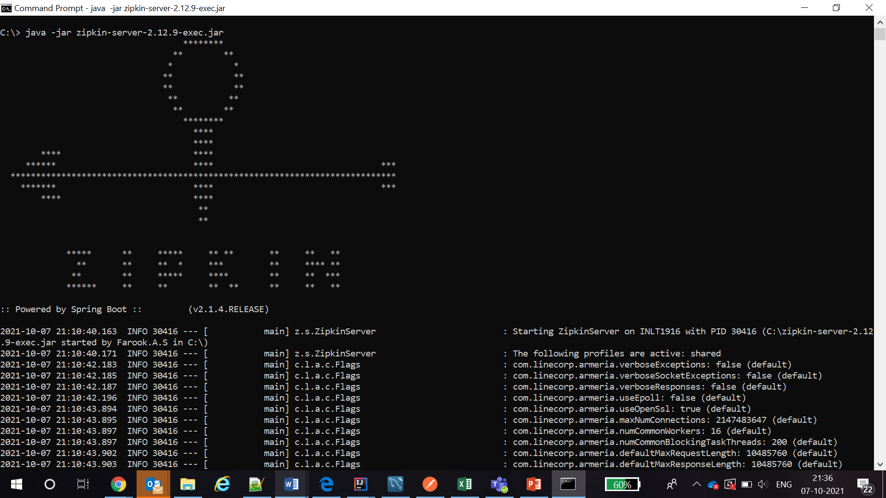

Slide 23
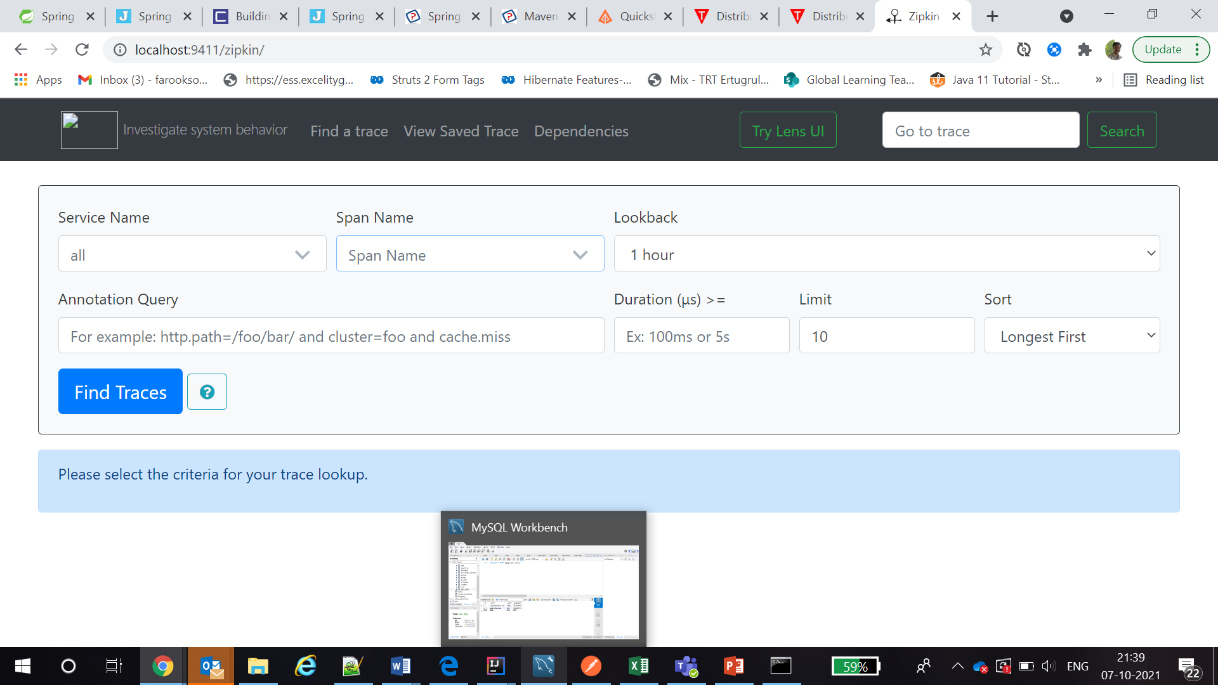

Slide 24
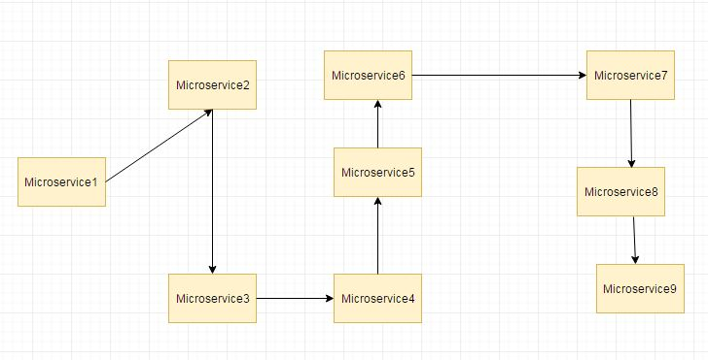
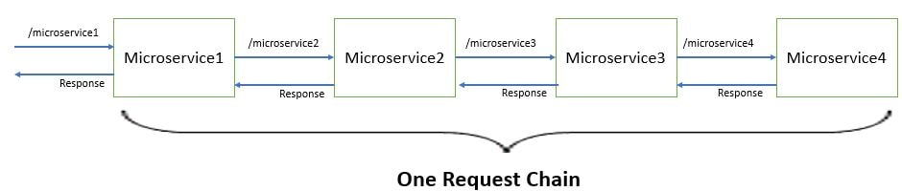

Slide 25
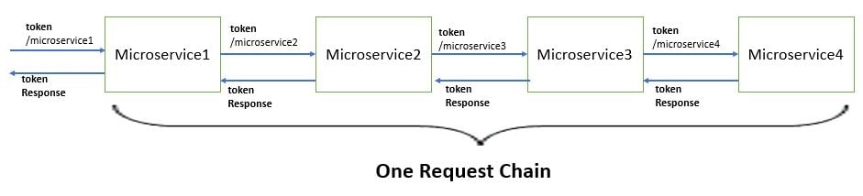
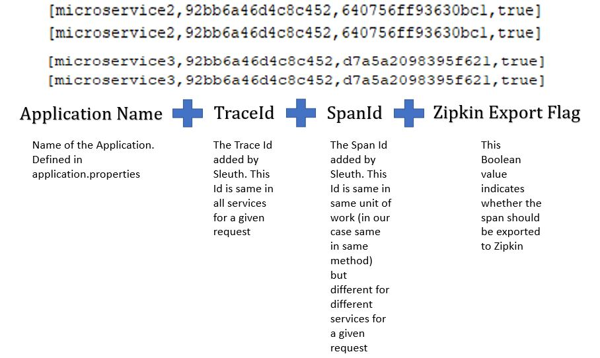
Implement distributed tracing using Spring Cloud Sleuth

Slide 26
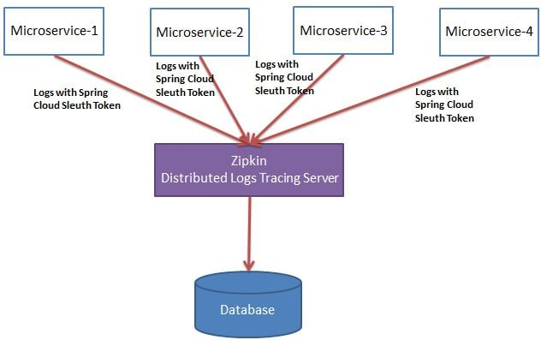
Use Zipkin for distributed log analysis-
@Bean
public Sampler defaultSampler() {
return Sampler.ALWAYS_SAMPLE;
}

Slide 27
AGILE

Slide 28
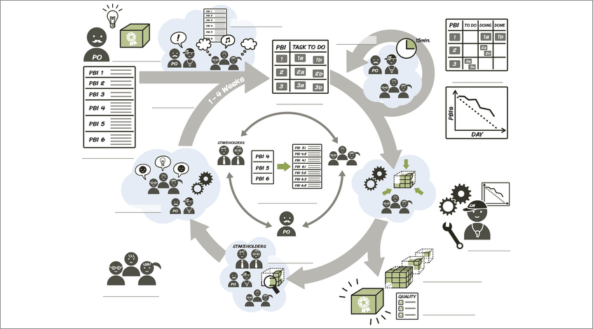

Slide 29
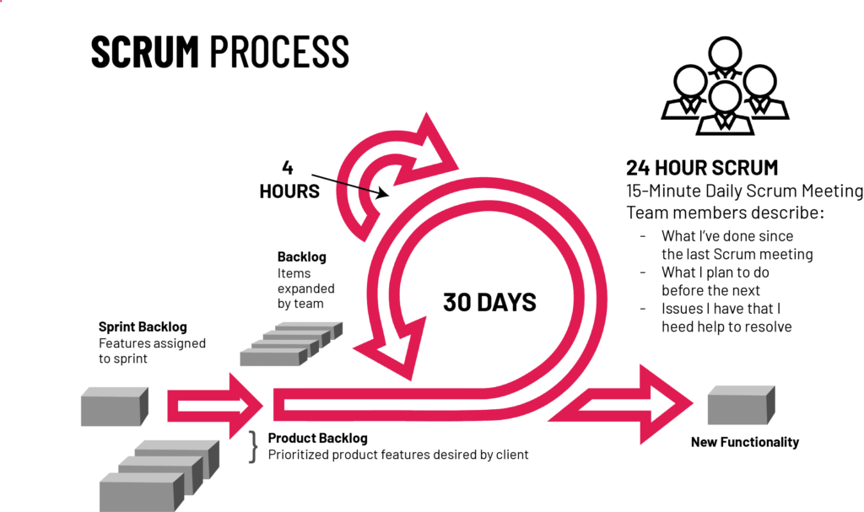
WHAT IS SCRUM?

Slide 30
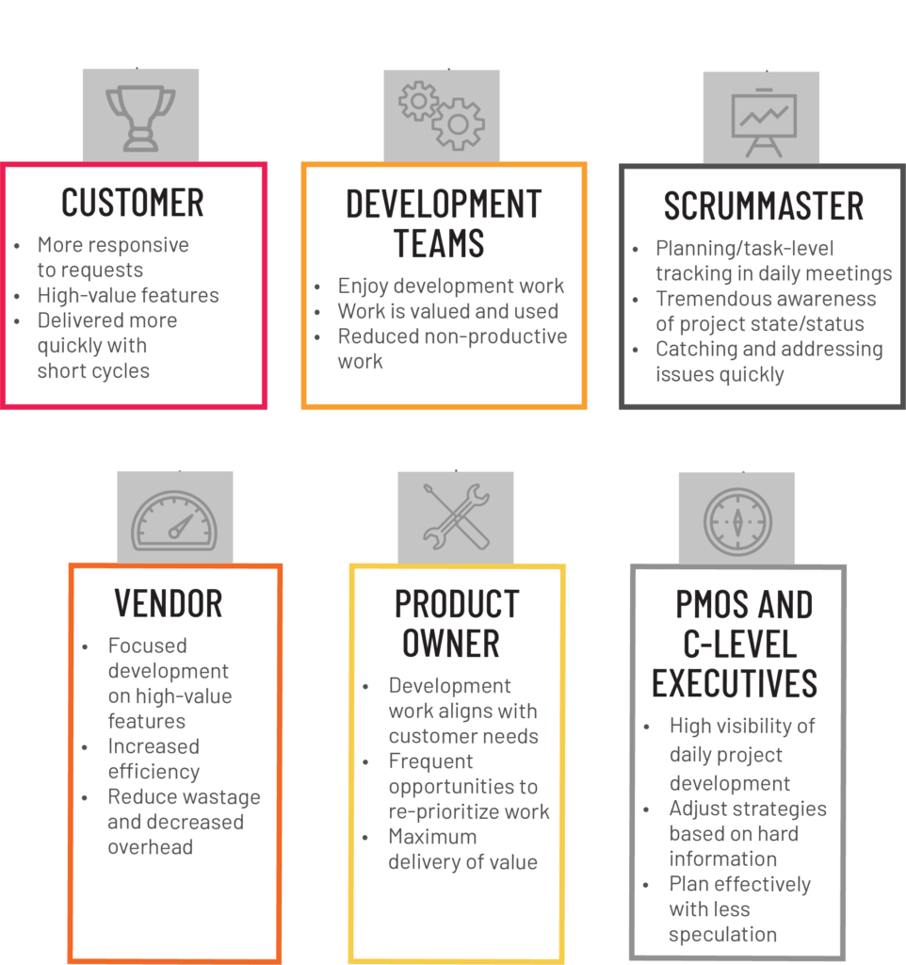
WHAT ARE THE BENEFITS OF AGILE?

Slide 31
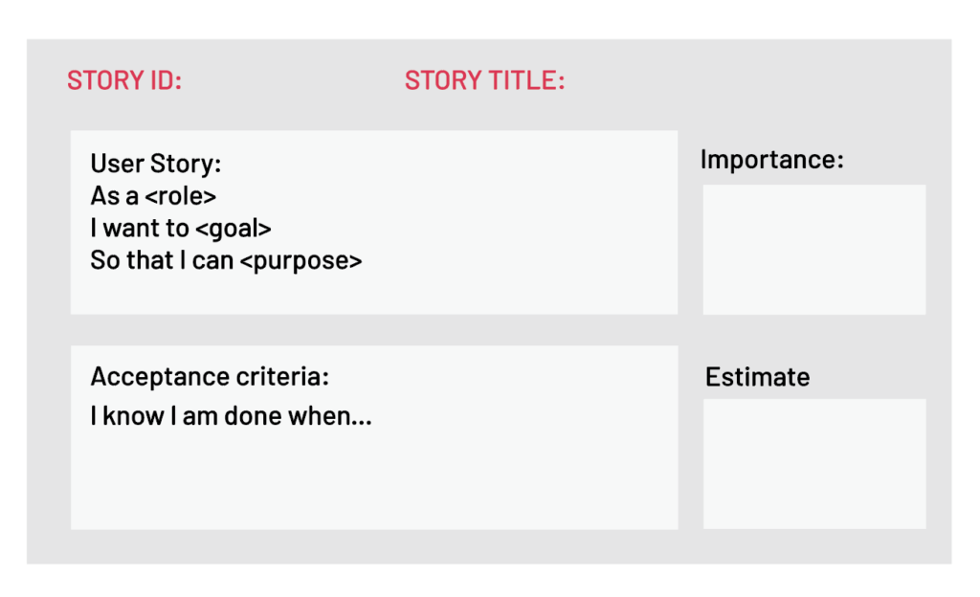
WHAT ARE THE SCRUM REQUIREMENTS?

Slide 32
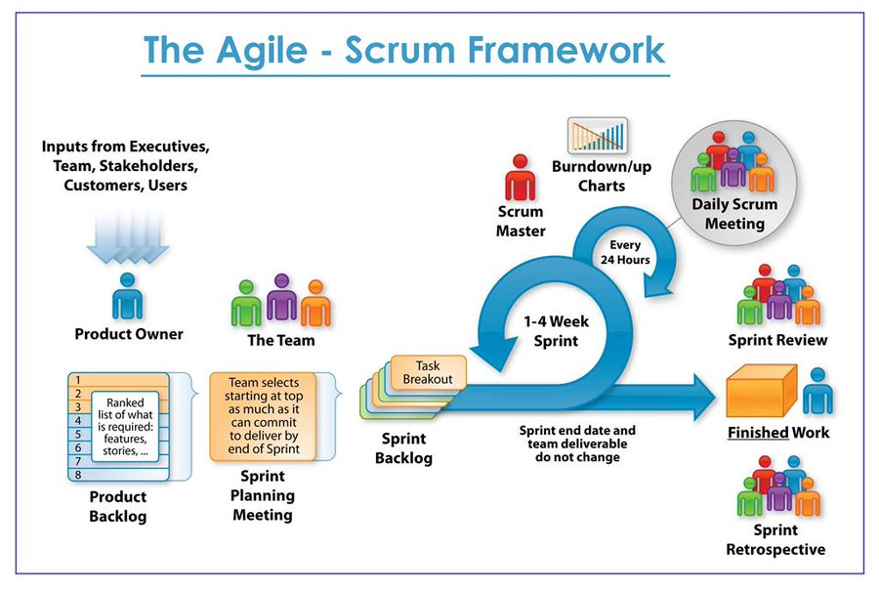

Slide 33
ELK Stack

Slide 34
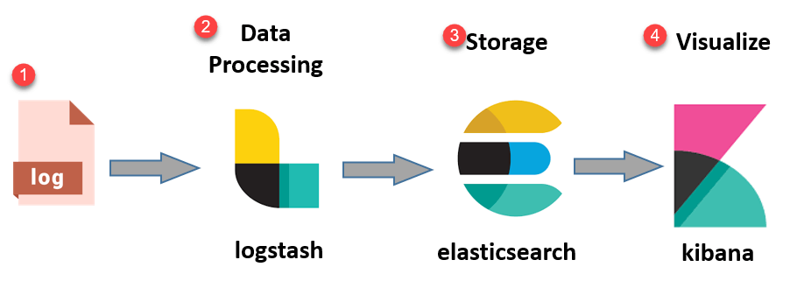

Slide 35
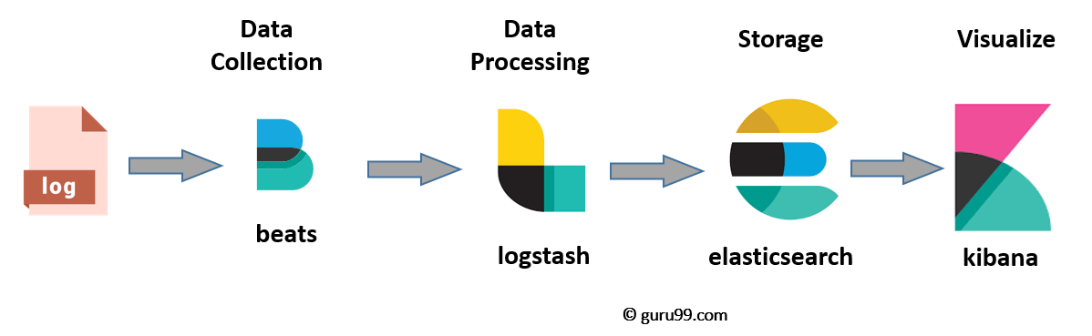

Slide 36
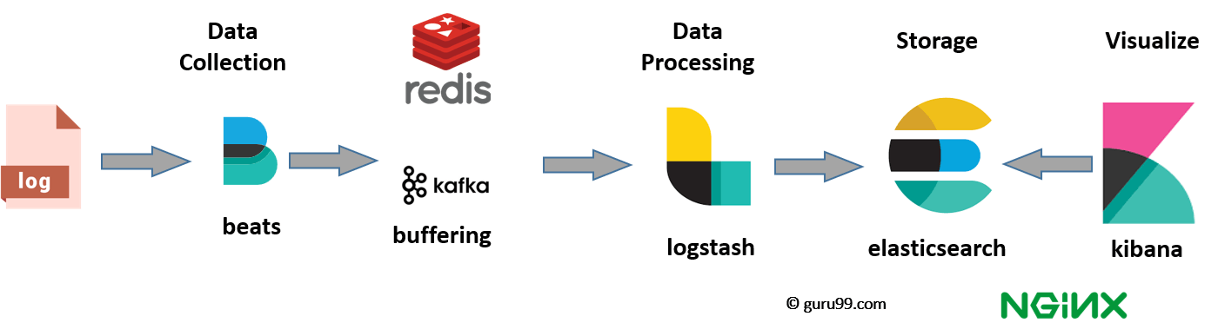

Slide 37
What is Elasticsearch?
Elasticsearch is a NoSQL database.
Elasticsearch also allows you to store, search and analyze big volume of data.
Features of Elastic search:
Open source search server is written using Java
Used to index any kind of heterogeneous data
Has REST API web-interface with JSON output
Full-Text Search
Near Real Time (NRT) search
Sharded, replicated searchable, JSON document store
Schema-free, REST & JSON based distributed document store
Multi-language & Geolocation support

Slide 38
Important Terms used in Elastic Search
Cluster
Node
Index
Document
Shard

Slide 39
What is Logstash?
Logstash is the data collection pipeline tool.
It consists of three components:
Input
Filters
Output

Slide 40
What is Kibana?
Kibana is a data visualization which completes the ELK stack.
The most common search types:
Free text searches
Field-level searches
Logical statements
Proximity searches

Slide 41
Case Studies
Netflix
LinkedIn
TripWire
Medium

Slide 42
Micro Service Best Practice & Migration

Slide 43
Best Practices to Migrate Monolithic Applications to Microservices
Understand the business objectives
Identify the benefits which will add business value and increase productivity
Use a separate database system for each microservice
Automate as much as possible
Cache data to improve performance
Choose the appropriate programming language
Understand the mission
Effectively monitoring the microservices

Slide 44
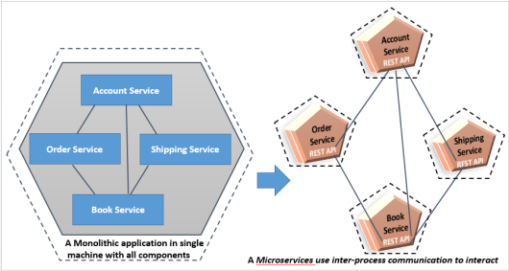
Microservices Inter-Service Communication

Slide 45
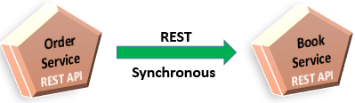
Synchronous Communication style

Slide 46
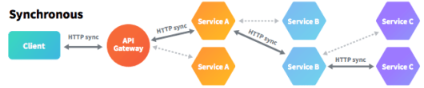
Synchronous one-to-one communication style

Slide 47
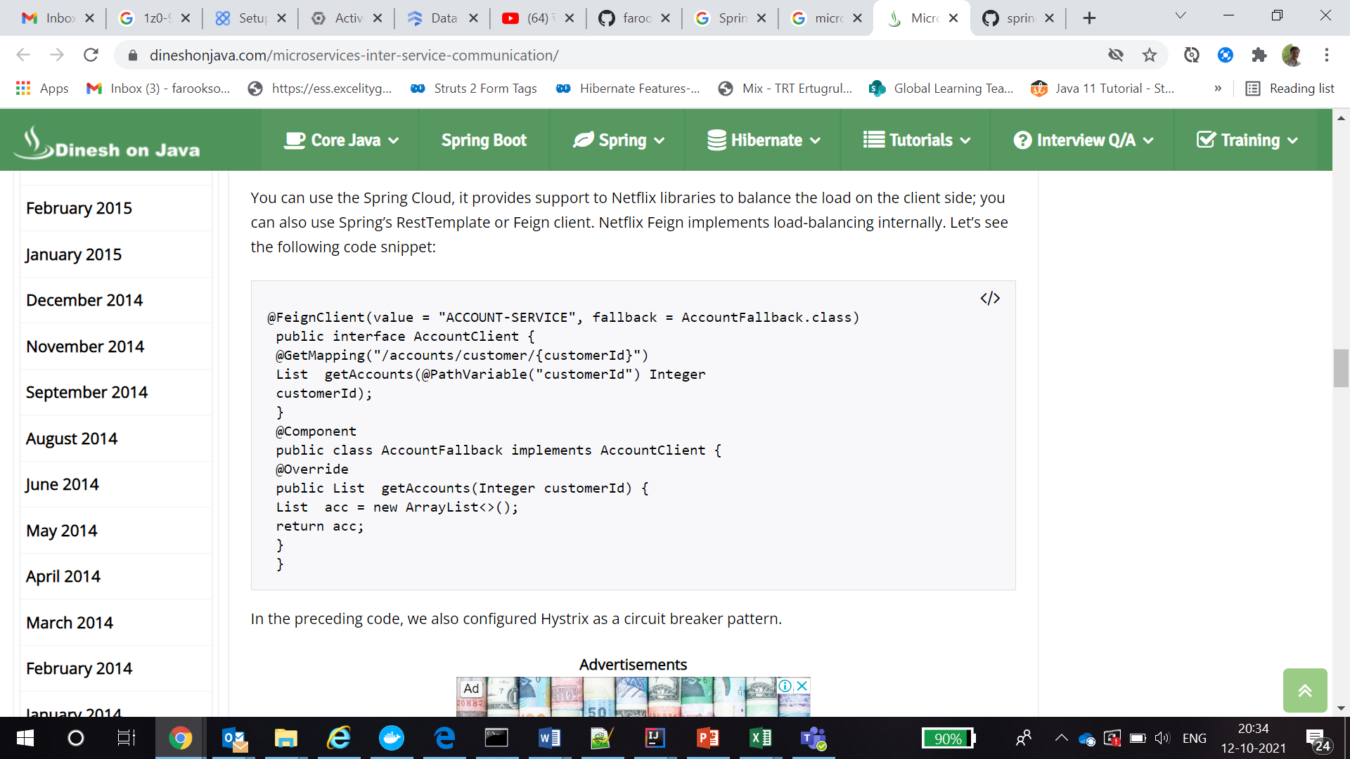

Slide 48
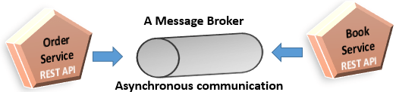
Asynchronous communication style

Slide 49
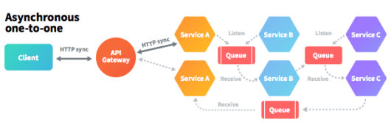
Asynchronous one-to-one communication style

Slide 50
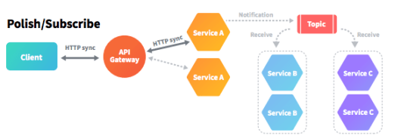
Asynchronous one-to-many communication style

Slide 51
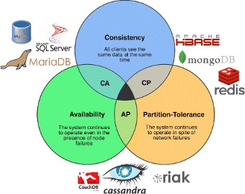
Managing Data in Microservices Architecture

Slide 52
Problems of having microservices using a shared database
Single point of failure
Performance bottleneck
Service dependency
Not autonomous

Slide 53
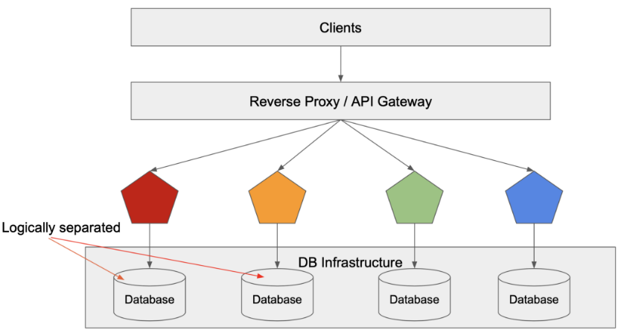

Slide 54
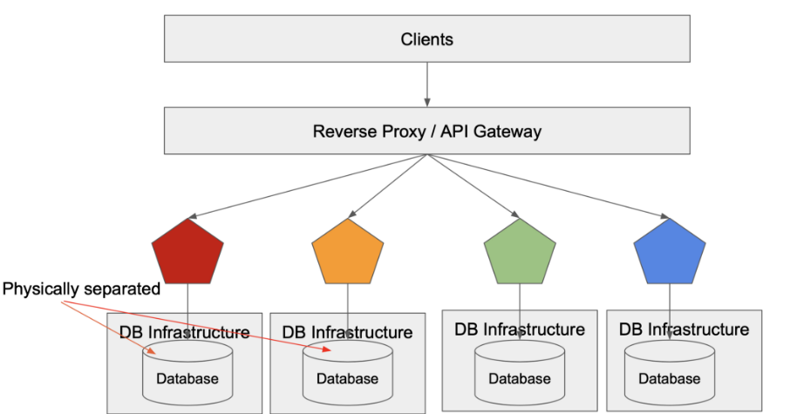

Slide 55
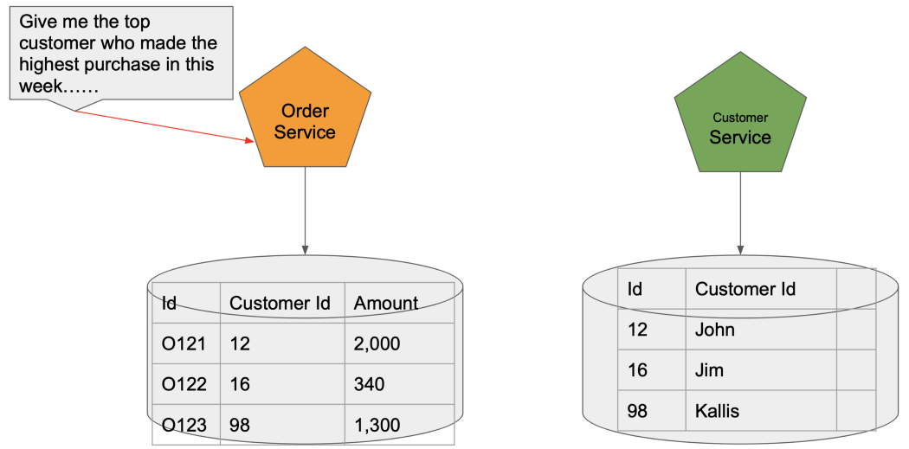

Slide 56
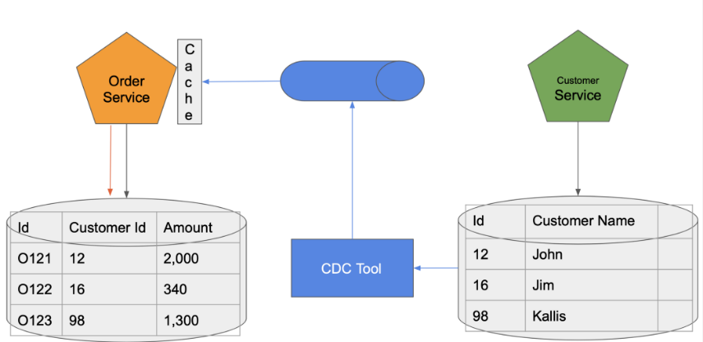
Technologies for Data Separation

Slide 57

A Data Reporting Scenario

Slide 58


Slide 59

Monolith to Microservices Data Migration

Slide 60

The journey from Development to Production

Slide 61

Building a APP

Slide 62
Building with ‘The Right Approach’
There are two major concepts which we are going to discuss
Microservices
Packaging

Slide 63

How Microservices will help in development?
Building a reusable End-to-End Pipeline
Collaboration

Slide 64
Packaging and its benefits
ROI
Standardization and Productivity
CI Efficiency
Compatibility and Maintainability
Rapid Deployment
Multi-Cloud Platforms
Isolation

Slide 65

Project Governance
Governance Models
Accountability and Responsibilities
Project Initialization

Slide 66

Project Governance
Git Ops & compliance

Slide 67
The 5 principles of cloud service management and operations
Operations
Monitoring
Eventing and alerting
Collaboration
Root cause analysis

Slide 68
DOCKER

Slide 69


Slide 70




Slide 71


Slide 72


Slide 73

Prometheus & Grafana

Slide 74

Grafana

Slide 75
Breaking Monolith into Microservices

Slide 76


Slide 77

Warm Up with a Simple and Fairly Decoupled Capability

Slide 78

Minimize Dependency Back to the Monolith

Slide 79

Split Sticky Capabilities Early

Slide 80

Decouple Vertically and Release the Data Early

Slide 81

Decouple Capability and not Code

Slide 82

Go Macro First, then Micro

Slide 83
Redis

Slide 84
In-Memory, Key-Value Store
Key-Value store is a storage system where data is stored in form of key and value pairs.
name="narayan" profession=["web", "mobile"]

Slide 85

Redis Single Instance Architecture

Slide 86
Redis Persistance
RDB Mechanism
AOF
Save Command

Slide 87

Redis Replication

Slide 88

Clustering In Redis

Slide 89

Clustering And Replication Together

Slide 90
Spring Boot cache with Redis
In-memory Caching
Database Caching
Web server Caching
CDN Caching
@EnableCaching
@Caching
@CacheConfig
@Cacheable
@CacheEvict
@CachePut

Slide 91

THANKS!

